Slide 1
Data Pipelines
CS4981 ML Production Systems
RJ Nowling

Slide 2

Machine Learning Models
P(purchase|item viewed)
P(purchase again|elapsed time)
P(purchase|other item)

Slide 3
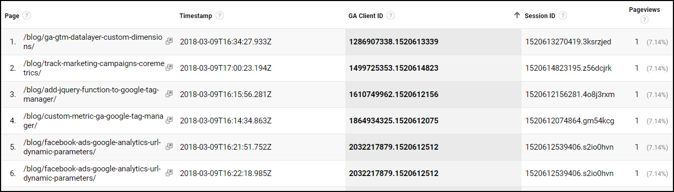
Session-Level Features
https://mixedanalytics.com/blog/quickstart-google-analytics-clickstream-data/

Slide 4
Device Profile
Attribute | Description
Device | Computer, tablet, phone; Infer capability / cost of machine -> buying power / technical sophistication
OS | Infer capability / cost of machine -> buying power / technical sophistication
OS version | Infer capability / cost of machine -> buying power / technical sophistication
Browser | MS browser users more likely to click on ads (less sophisticated users)
Browser version | Older software -> less sophisticated -> more likely to click on ads
Screen resolution | Infer capability / cost of machine -> buying power / technical sophistication
Geographic Location

Slide 5
Product Level
Attribute | Description
Product categories and sub-categories | In general, interested in a job For this web site, interests in this company specifically
Product popularity
Product prices
Consumable | E.g., dog food vs socks
Description
Product sizes

Slide 6
User Profile
Attribute | Description
Gender
Age Range | Usually organized as ranges (e.g., < 18, 18-24, 25-30, etc.)
Education | High school, college, graduate degrees
Income | Organized as ranges
Employment | What industry (e.g., customer service, retail, software, education, etc.)? White collar or blue collar?
Interests | E.g., sports, clothing, etc.
Children | Have they browsed or purchased children's items? What age ranges?
Number of online purchases per month
Amount of monthly online purchases

Slide 7
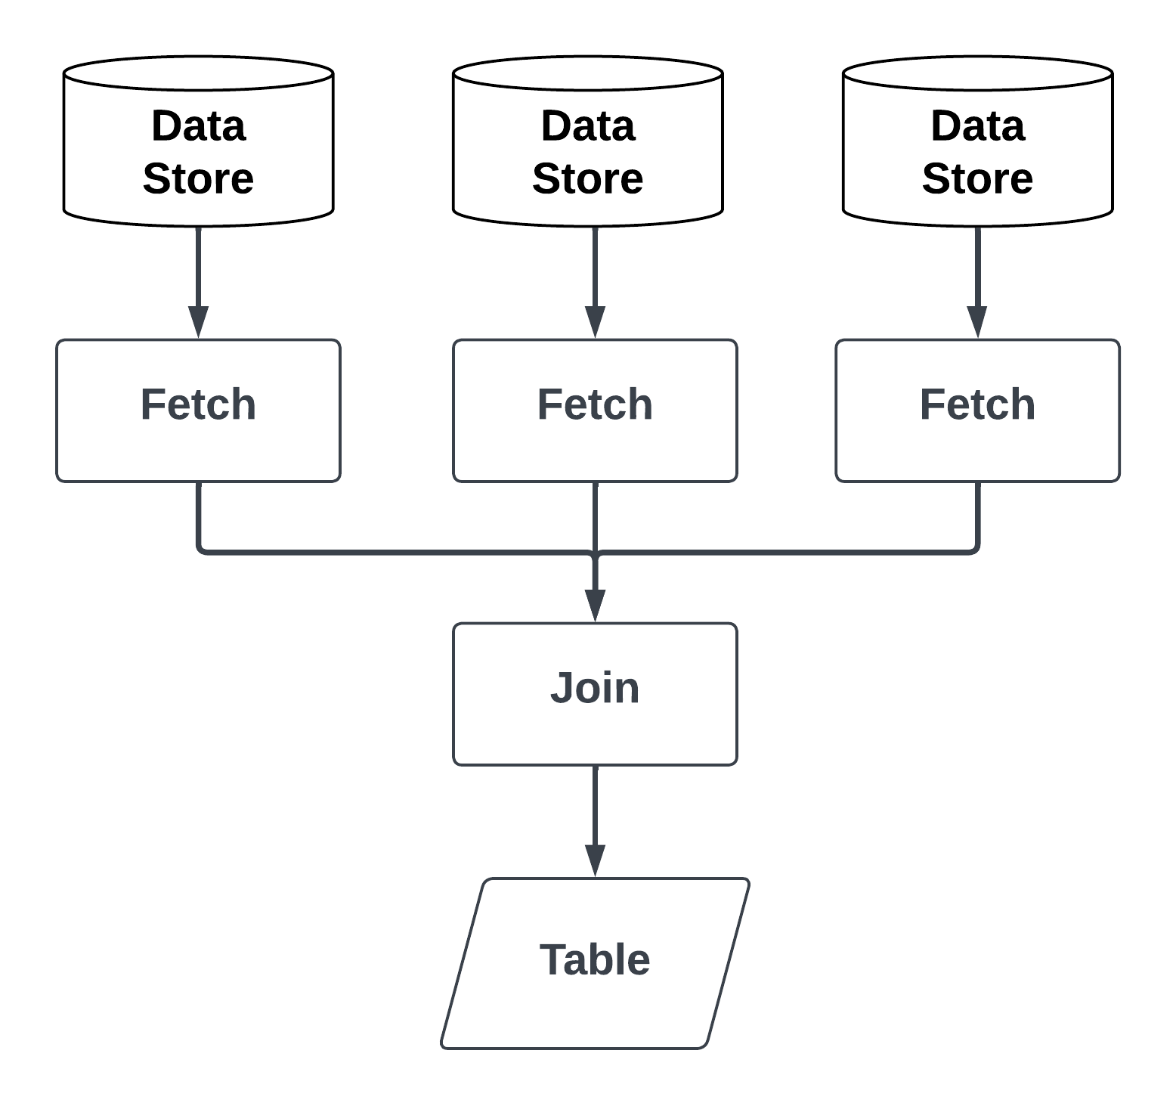
Fetch and Join
For complex ML models,
multiple data sets need to be
fetched
cleaned
joined into a single table
before feature extraction can be performed

Slide 8
Fetch and Join
This is needed for all three stages:
Offline training
Offline evaluation
Online prediction

Slide 9
Fetch and Join
Requirements differ
Offline: no latency requirements (jobs can run for a few hours), operates on large batches of records
Online: latency restrictions (e.g., a few to tens of ms responses expected), only needs a handful of records

Slide 10
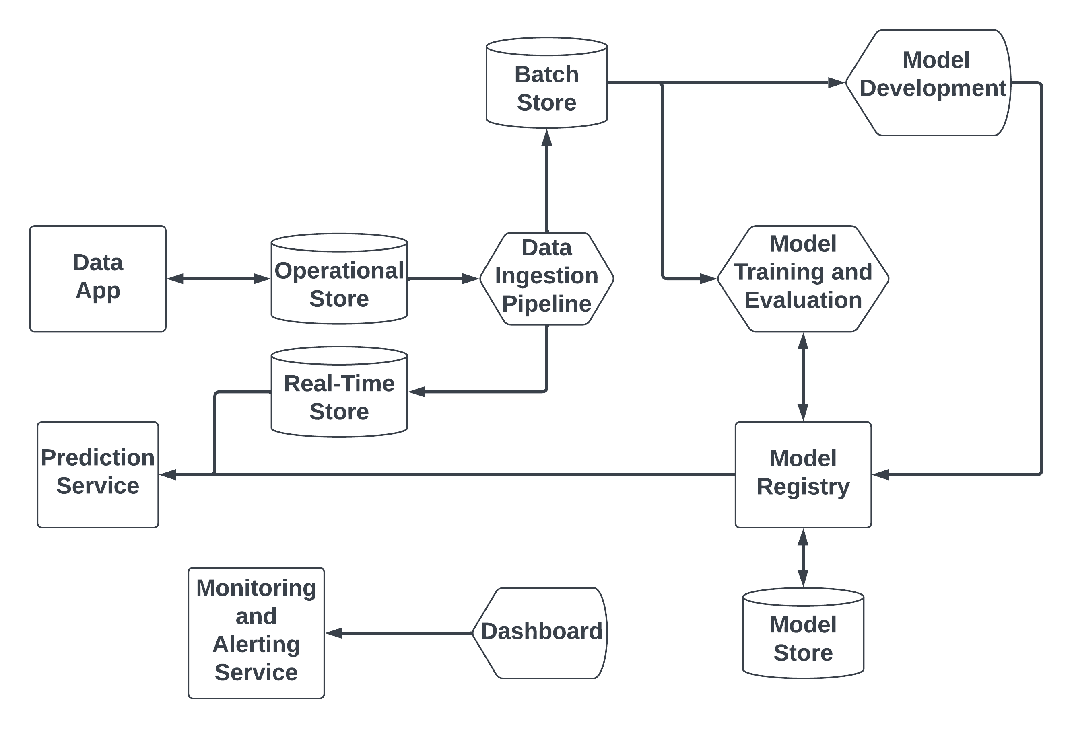
Generalized Architecture

Slide 11
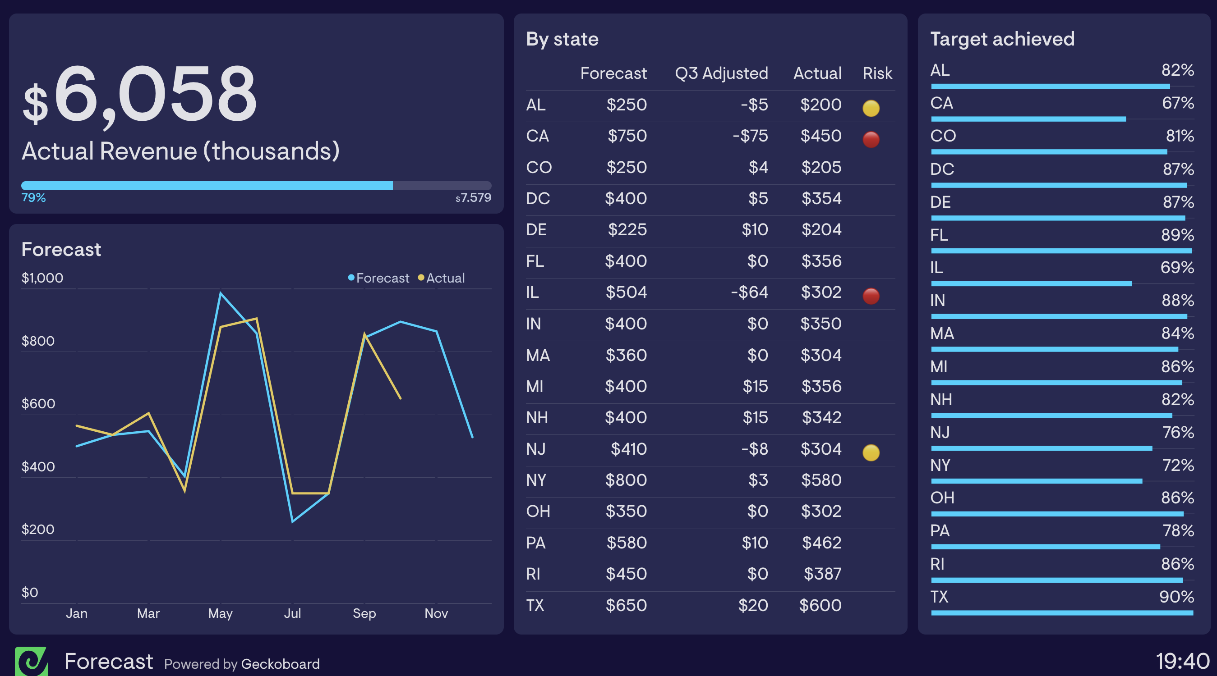
Extracting Efficiency
Perform computationally expensive analytics queries
Queries cannot be performed in real time
Need to be pre-computed on periodic basis
Useful for crunching data used in dashboards

Slide 12
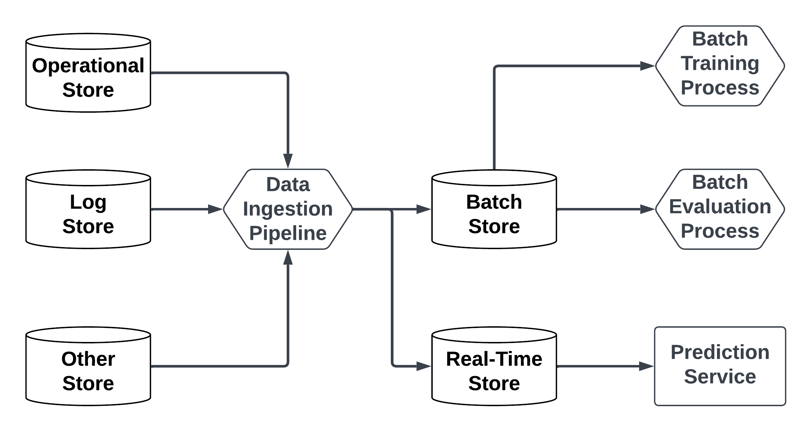
Extracting Efficiency
Simplifies model development
Generate data sets for each time period once
Use across multiple experiments instead of generating for each experiment

Slide 13
Data Freshness
Keeps training and evaluation data sets fresh
Keeps real-time store updated with recent versions of records to generate most accurate predictions

Slide 14
Runs Periodically / Continuously
Runs periodically (batch)
or continuously (streaming)
to update processed data sets

Slide 15
Data Stores
Operational Stores
Analytics Stores
Optimized for low-latency read-write operations with
Small numbers of records per connection
Many concurrent connections
Optimized for high-throughput read-write operations with
Many records per connection
Very few concurrent connections

Slide 16
Generalized Architecture

Slide 17
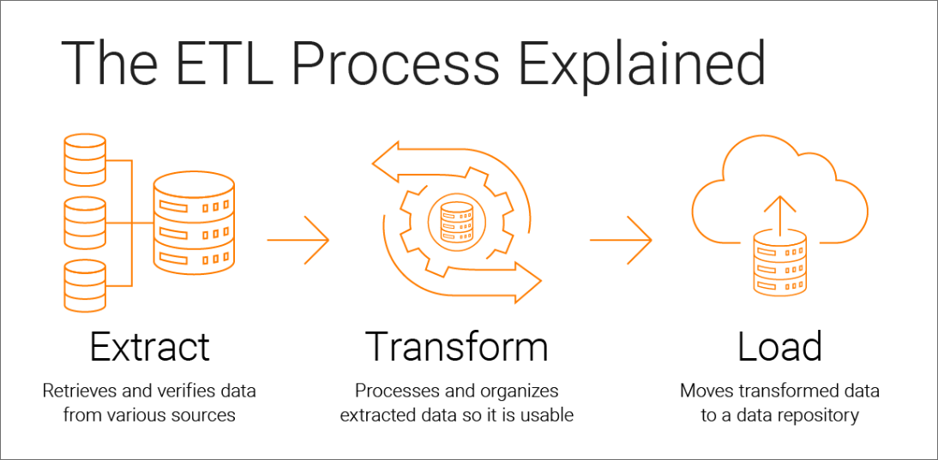
Extract Transform Load
Source: https://www.informatica.com/tw/resources/articles/what-is-etl.html

Slide 18
Examples of Transformations
Joining tables
Deduplicating records
Aggregations
Calculating derived columns
Changing column types / value representations
Splitting complex values into simpler values
Ensuring consistent representations of values
Quality control: unexpected values, missing values, improperly typed values

Slide 19
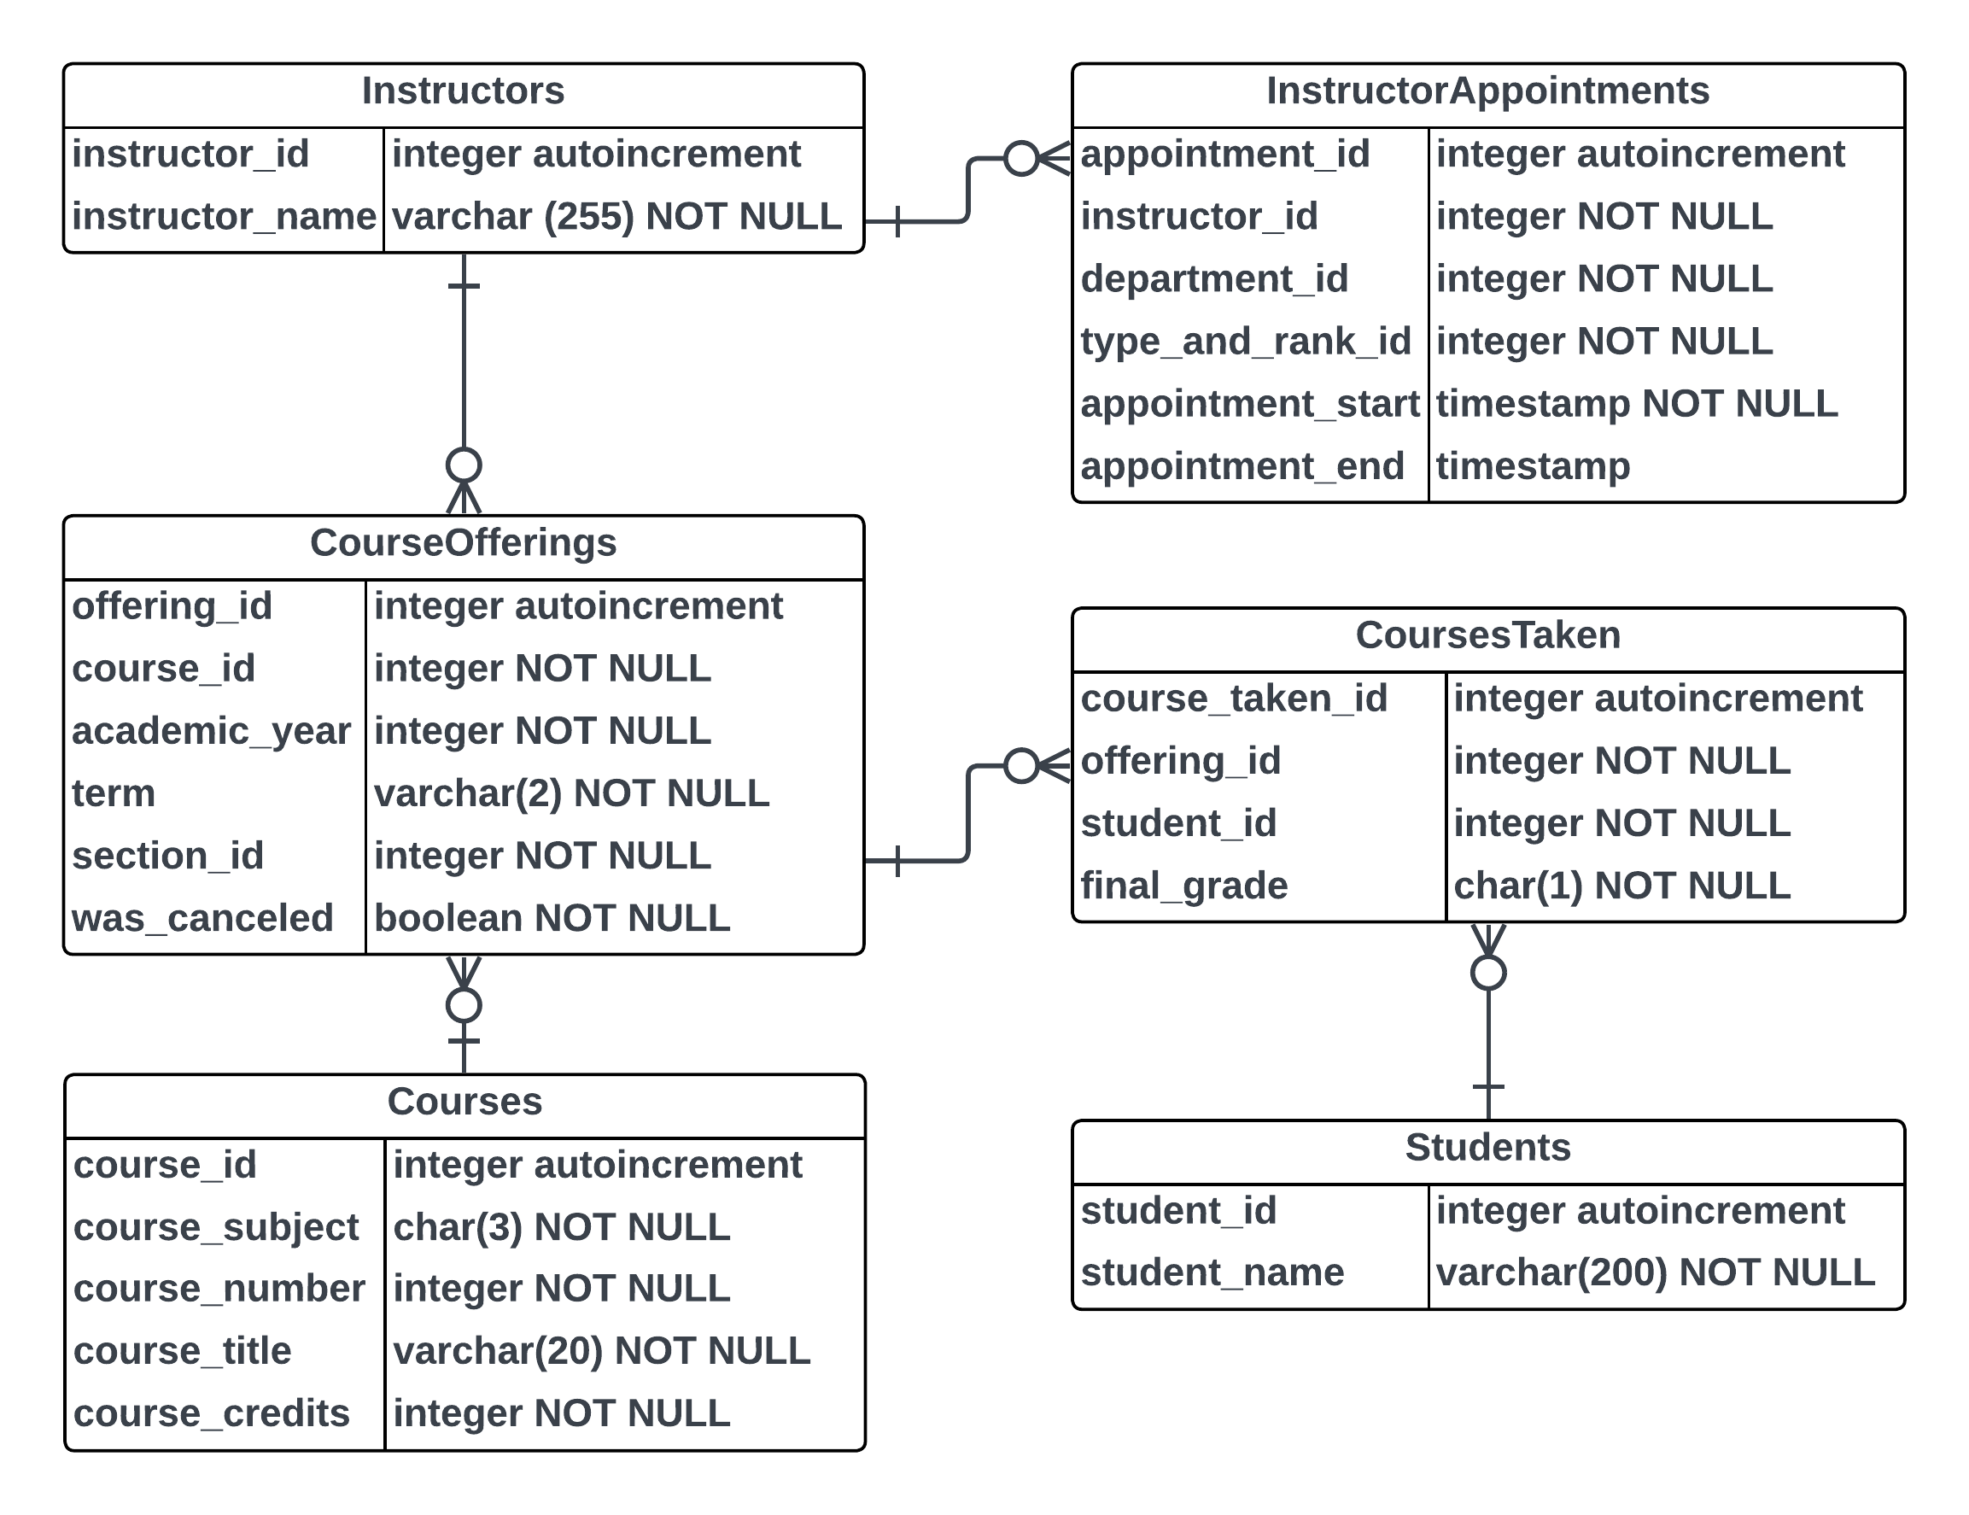
Example Input Data

Slide 20
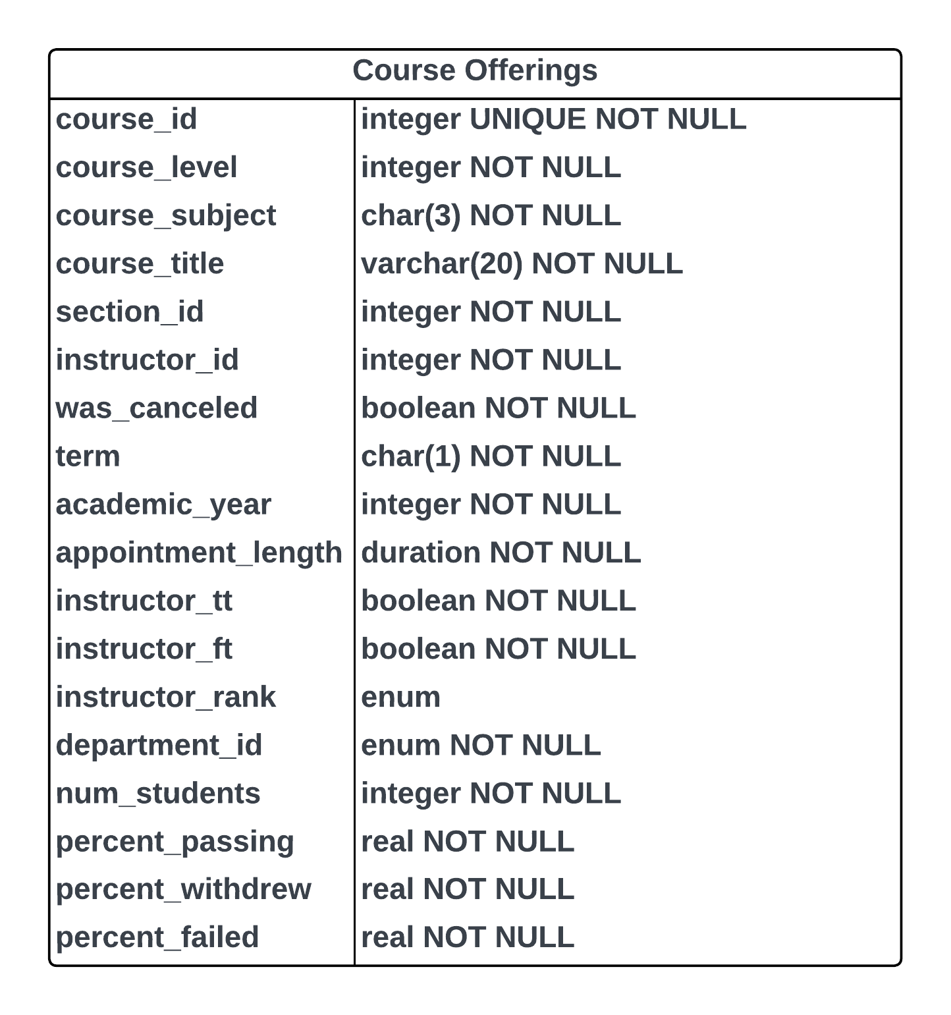
Example Transformed Data

Slide 21
Processing New and Changed Records
All Data
Do not want to make a copy of all data in every run of the pipeline
For efficiency, we only want to process new and updated records
Reduces load on the operational store
Reduces the computational resources (and hence costs and run time) needed to run pipelines
Changed Data

Slide 22
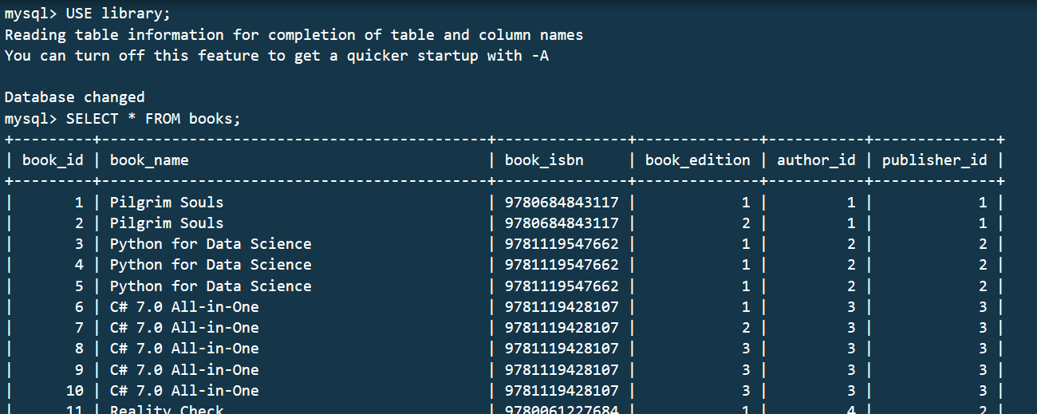
Approach #1: Append-Only Schema
Every change to a record involves writing an entirely new record
Add fields for creation and deletion times
Primary key of the records include the creation time
"Deleted" records are not actually deleted -- setting a deletion time marks the record as deleted and it is ignored in queries (soft deletes)

Slide 23
Approach #1: Append-Only Schema
Pros
Cons
Easy to reprocess data in case of failures
Pattern is consistent with what might be used in the analytics store
Relatively simple pipeline implementations: query records created within specified time ranges
Have to modify all queries to grab the latest version of each record
Modify all services using the databases
Impedes usage of ORMs
But, what if you don't control the service (e.g., off-the-shelf product)?
Balloons the size of the data

Slide 24
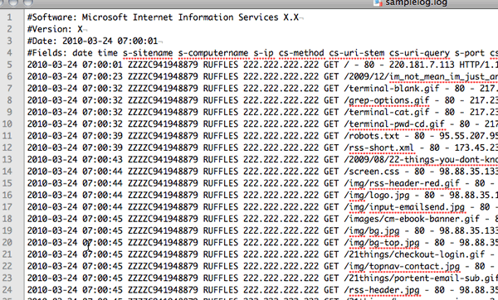
Approach #2: Logging Updated Records
Changed records will both be written to
the operational database AND
log files
The logs can be processed in batches in an offline manner

Slide 25
Approach #2: Logging Updated Records
Within the Service
From the Database
The service is modified to perform both types of writes (databases and logs) for every change
Change data capture (CDC) solutions monitor the replication logs of databases
Write replication logs into an open format consumable by a third-party tool

Slide 26
Approach #2: Logging Updated Records
Pros
Cons
No need to change database schema -- greater compatibility with ORMs
Logs can be reprocessed as needed
Less load on the operational database (fewer large queries against it)
CDC can be used without changing the service
Needs to store and transport the logs
Requires more complicated pipelines (more infrastructure)

Slide 27

Time Travel
We need to be able to access the state of records at any given time
Analytics stores often store multiple copies of records to support "time travel queries"
Operational stores often prioritize access to most recent records or have a mechanism for garbage collecting old records

Slide 28
Inferring Labels from Event Types
Past
Label

Slide 29
Inferring Labels from Event Types
Past
Label

Slide 30
Inferring Labels from Event Types
Past
Label

Slide 31
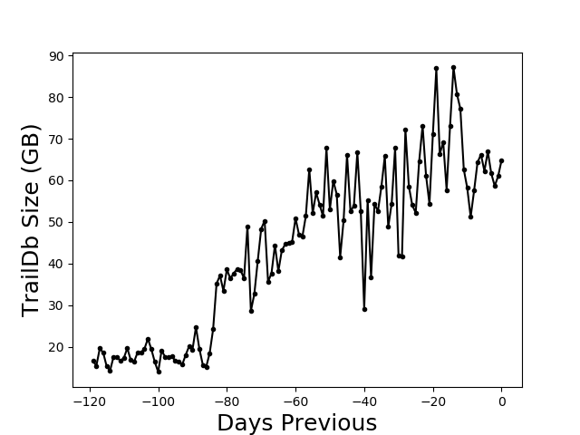
Train-Test Split for Time
Partition by Time
Used for data that depends on time (e.g., weather data)
Procedure
Choose a cutoff time: either a single point in time OR for each record individually
Training set: all records before the cutoff
Testing set: all records after the cutoff

Slide 32
Testing Data-Intensive Systems
Developing, testing, and debugging data pipelines can be challenging
Full runs require substantial computational resources and can take several hours
Testing can be slow and expensive: inhibits development, reduces developer confidence, slows down new features and bug fixes
Remote operation limits the ability to use debuggers or capture output
Data pipelines are difficult to test independently: complex patterns in data can be difficult to mimic or recreate in subsets or simulated data

Slide 33
Avoiding Failures
If care isn't taken, a single malformed or incomplete record can cause a program to crash
Malformed records can be caused by:
Incomplete validation of data in upstream systems
Software bugs
Hardware or system failures
Usually can't easily excise a single record from a data set -- needs to be resolved by changing the pipeline code, redeploying, and rerunning

Slide 34
Avoiding Failures
Employ defensive programming techniques
Check for nulls
Write if-else statements such that nothing falls through to the else unless something unexpected happens
Be purposeful about where and how to handle exceptions
Be explicit about types (e.g., use classes instead of generic collections to model data)

Slide 35
Avoiding Failures
Employ data validation strategies
Define schemas that specify:
the expected types of fields
whether fields are optional or required
the names of fields
additional checks such as ranges, consistency across fields, etc.
Validation libraries such as marshmallow and
typed data interchange formats (e.g., Protocol Buffers, Apache Avro) can help

Slide 36
Avoiding Failures
Design pattern: catch failures / exceptions thrown when processing individual records
Log the failure so that operators are aware of the failures and developers can use the examples to improve the pipeline code
Continue with processing the remaining records

Slide 37
Avoiding Failures
Dynamically-typed languages such as Python and JavaScript are great for
exploratory work (e.g., data science)
prototyping systems
small systems
reducing upfront complexity of software development
Dynamic typing can be a liability in developing systems that need to be reliable

Slide 38
Avoiding Failures
Languages features that help with reliability
Static typing: prevents bugs where unexpected values (e.g., string instead of int) are propagated through systems
Forced handling of failures: Checked exceptions and result types make it explicit to the developer where failures can occur so they can be purposeful about handling them
Variables that can prevent the assignment of null values: prevents null-pointer exceptions
Languages like Java, Kotlin, Scala, C#, F#, Go, D, and Rust are popular for implementing systems with high-reliability requirements for a reason

Slide 39
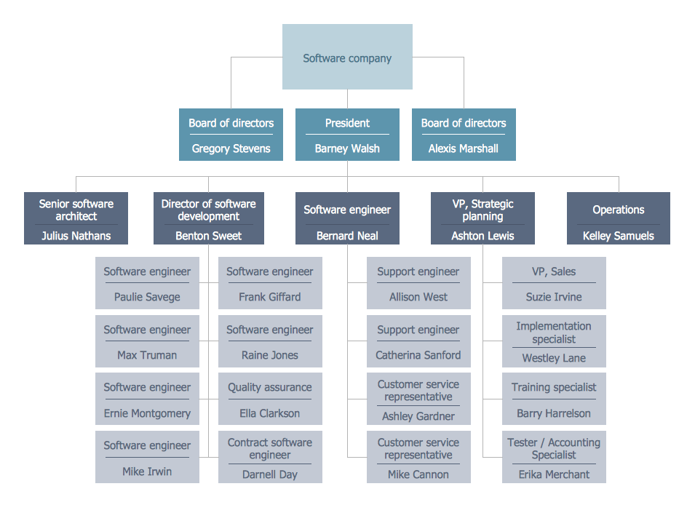
Organizational Structure
Who owns and maintains the data pipelines?
Centralized data team that services downstream teams?
Teams that consume the data?
Often a continuum
centralized data teams do processing needed by everybody
while downstream teams do further processing and ingestion into storage for their specific needs

Slide 40

Data Security
Companies often deal with confidential data
User browsing, purchasing, and consumption histories
Private communications
Personal information (names, addresses, etc.)
Companies need to limit access to the necessary employees and systems to prevent breaches

Slide 41
Data Security
Companies face multiple internal and external threats
Malicious employees: employees may use data to harass users or commit fraud
Employee mistakes: copying sensitive data to a personal laptop
External actors: may attempt to steal data (e.g., on an employee's laptop)

Slide 42
Data Security
Companies need to develop access models and policies that limit access to as few people as possible
IT and developers need to ensure that the access models and policies are implemented consistently across systems
Encryption or other mechanisms may be used

Slide 43
Data Security
Disparate components will likely not support the same security models
PostgreSQL uses a basic role-based access security (RBAC) model
Distributed file systems using the traditional Unix user/group or Microsoft Windows Access Control List (ACL) approach
Cloud providers provide sophisticated models that are designed to scale to large organizations with many different departments and types of roles

Slide 44
Data Security
Data, once copied out of a secure system, is completely vulnerable
E.g., if an employee downloads some data to their local machine and the laptop is stolen
Pipelines that copy data across systems can very easily circumvent carefully-planned security models

Slide 45
Data Security
Needs to be solved at both
the technological level (e.g., architecting data-intensive systems to consistently implement access policies)
and the process level (e.g., developers do not have access to raw data -- mock data are used for development and testing)

